Slide 1




PDS
Introduction to Kubernetes
Computer Vision
https://github.com/siagianp
https://www.youtube.com/@AmelOline/videos
https://github.com/amelcharolinesgn2/Cloud-Infrastructures
https://github.com/amelcharolinesgn2/ClouD-Infrastructure-SISKA-2025
https://github.com/amelcharolinesgn2/CCNA1
https://github.com/amelcharolinesgn2/CCNA2
https://github.com/amelcharolinesgn2/AWS Certificate
Notes:
Lab Session 01: AWS Compute Foundations – EC2, Networking, and Application Deployment Lab Session 02: Identity and Access Control with IAM Lab Session 03: Cloud Storage Solutions – S3, EBS, and EFS Lab Session 04: Database Services – RDS, DynamoDB, and ElastiCache Lab Session 05: Load Balancing and Auto Scaling Lab Session 06: Container Orchestration with ECS, Fargate, and EKS Lab Session 07: Serverless Computing with Lambda Lab Session 08: Monitoring, Logging, and Security Auditing Lab Session 09: Infrastructure as Code – CloudFormation, CDK, and Terraform Lab Session 10: CI/CD Pipelines – App Runner, CodePipeline, GitHub Actions, and CodeDeploy Lab Session 11: AI/ML Services – Rekognition, Comprehend, Translate, and SageMaker Lab Session 12: Hybrid Cloud Networking – VPC Peering, Transit Gateway, VPN, and Direct Connect Lab Session 13: Security and Compliance – AWS Config, GuardDuty, Security Hub, and KMS Lab Session 14: Disaster Recovery and Business Continuity – AWS Backup, Multi-Region, and Failover Lab Session 15: Migration and Modernization – DataSync, DMS, MGN, Containers, and Serverless
Lab Session 16: Cost Management and Optimization – Cost Explorer, Trusted Advisor, Budgets, and Well-Architected
https://www.youtube.com/watch?v=SOTamWNgDKc&t=19604s

Slide 2
Introduction to Kubernetes
Understanding the Basics of Container Orchestration

Slide 3
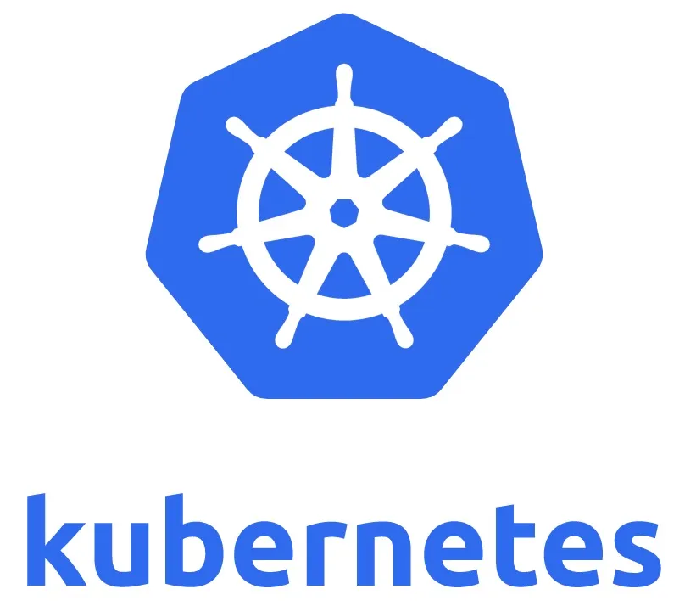
What is Kubernetes?
Kubernetes (K8s) is an open-source platform designed to automate deploying, scaling, and operating containerized applications.
Originally developed by Google, now maintained by the Cloud Native Computing Foundation (CNCF).
Helps manage clusters of containers.

Slide 4
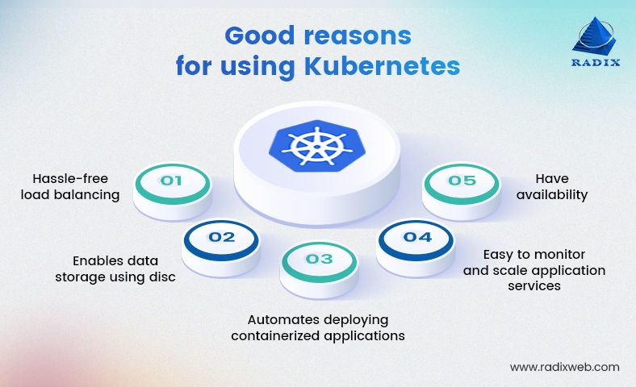
Why Use Kubernetes?
Automates container deployment and scaling.
Ensures application availability and fault tolerance.
Simplifies resource management.

Slide 5
Kubernetes Architecture
Master node and worker nodes architecture.
Control Plane: API Server, Scheduler, Controller Manager.
Worker Plane: Kubelet, Kube Proxy.
Etcd as a distributed key-value store.

Slide 6
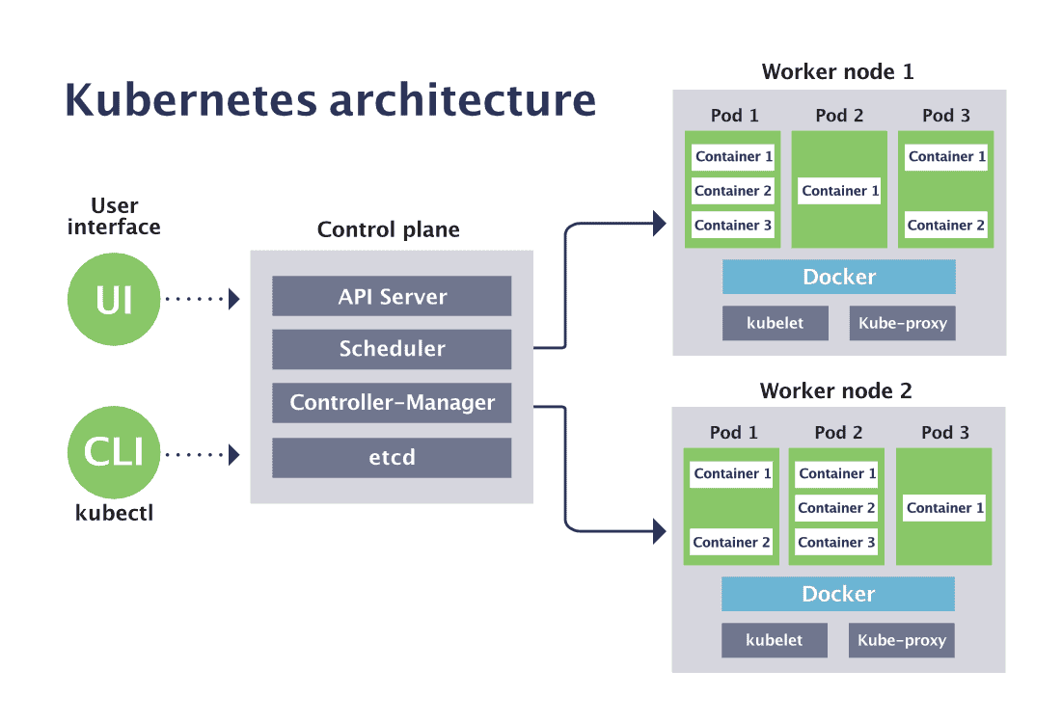

Slide 7
Architecture Details
Control Plane: Manages the cluster's overall operations through components like API Server, Scheduler, and Controller Manager.
  API Server: Central communication hub for the Kubernetes cluster, handling REST API requests.
  Scheduler: Assigns Pods to nodes based on resource availability and constraints.
  Controller Manager: Ensures the cluster's desired state by running controllers like Node and Replication Controllers.
  etcd: A distributed, highly available key-value store used by Kubernetes to store all cluster data, including configuration, state, and metadata. It ensures consistency across the cluster.
Worker Plane: Executes workloads on nodes using Kubelet (container management) and Kube Proxy (networking).
  Kubelet: Manages containers on a worker node, ensuring they are running as instructed.
  Kube Proxy: Handles networking, enabling communication between Pods and Services.

Slide 8
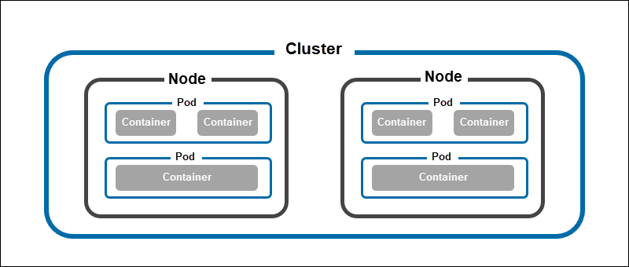
Cluster

Slide 9
How Kubernetes Works
Uses declarative configuration and desired state.
Schedules workloads on worker nodes.
Monitors application health.
Self-heals by restarting failed containers.

Slide 10
Key Kubernetes Objects
Pod: Group of containers.
Service: Exposes application as a network service.
ConfigMap: External configuration for Pods.
Ingress: HTTP and HTTPS routing.
Deployment: Manages replicas of Pods.

Slide 11
Benefits of Kubernetes
High availability.
Scalability and performance.
Portability across environments.
Cost optimization with resource management.

Slide 12
Popular Use Cases
Microservices architecture.
Batch processing and CI/CD pipelines.
Edge computing and IoT.
Hybrid and multi-cloud setups.

Slide 13
Getting Started with Kubernetes
Install Minikube or use a managed Kubernetes service (e.g., GKE, EKS, AKS).
Write configuration files in YAML.
Use kubectl for cluster management.

Slide 14
Challenges of Kubernetes
Complexity in setup and management.
Steep learning curve.
Security and monitoring concerns.
Resource overhead.

Slide 15
Conclusion
Kubernetes is a powerful tool for managing containerized applications.
Its robust features and scalability make it ideal for modern application deployment.
Embrace Kubernetes to simplify and optimize your infrastructure.

Slide 16
THANK YOU
Amel charoline
Amel Online & Irene magdalena
https://github.com/siagianp
https://www.youtube.com/@AmelOline/videos
https://github.com/amelcharolinesgn2/Cloud-Infrastructures
https://github.com/amelcharolinesgn2/ClouD-Infrastructure-SISKA-2025
https://github.com/amelcharolinesgn2/CCNA1
https://github.com/amelcharolinesgn2/CCNA2
https://github.com/amelcharolinesgn2/AWS Certificate

